Slide 1

Chhattisgarh Swami Vivekanand Technical University University Teaching Department Department of Computer Science and Engineering
Presented By
# Name: Durgesh Kumar
Dewangan
#Roll No: 300012723018
#Branch: CSE(AI)
Internship Progress Report
On
*rAI & xAI Framework for LLM Systems Testing and Validation*
#Mentored by#
Mr. Bhushan Gangurde
ML-I Engineer at
TestAIng Solutions Pvt. Ltd(aiensured)

Slide 2
Content
Introduction
Problem Statement
Objectives & Scope
Background / Existing Solutions
Methodology
Work Done (Month 3)
Results
Challenges
Current Status
Future Work
Learning Outcomes
Conclusion

Slide 3
Introduction
Large Language Models (LLMs) are widely used for:
However, they suffer from:
To address this:
This project focuses on:
question answering
document analysis
hallucination (incorrect responses)
lack of explainability
Retrieval-Augmented Generation (RAG) is used
improving reliability using Multi-RAG
integrating Responsible AI (rAI) and Explainable AI (xAI)

Slide 4
Problem Statement / Motivation
LLMs generate responses without verifying facts
Major issues:
hallucinated answers
irrelevant context
lack of transparency
Motive:
Build a system that:
retrieves correct context
generates reliable answers
can be validated and explained

Slide 5
Objectives & Scope
Objectives:
Build a RAG-based document QA system
Improve retrieval using Multi-RAG
Reduce hallucination in LLM outputs
Introduce evaluation mechanisms (rAI)
Scope:
Enterprise document intelligence
AI validation systems
Explainable AI integration (future phase)

Slide 6
Background /Existing Solutions (for Projects)
Existing Systems:
Standard LLMs:
generate answers without context
Basic RAG:
retrieves context but has limitations
Limitations:
Single retrieval strategy
Poor ranking of context
Still produces hallucinations
Gap Identified:
Need for Hybrid Retrieval + Context Optimization

Slide 7
Methodology / Approach
Month 1 Approach (Basic RAG)
Document → Text Extraction
Chunking
Embedding Generation
Vector Storage (FAISS)
Retrieval + LLM
Month 2 Approach (Multi-RAG)
Query Input
Multi Retrieval:
vector search
keyword search
Combine Results
Re-rank Context
LLM Response

Slide 8
Work Completed
Month 1
Built:
document ingestion pipeline
embedding system
FAISS vector database
Developed:
Basic RAG prototype
Month 2
Designed Multi-RAG architecture
Implemented:
hybrid retrieval (vector + keyword)
context re-ranking
Improved:
prompt engineering

Slide 9
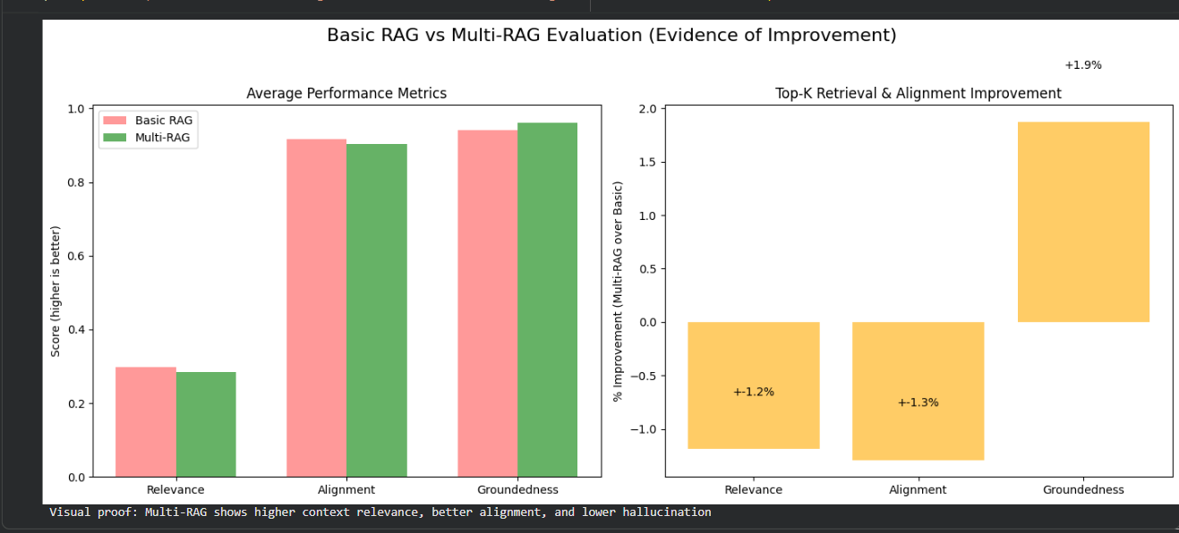
Results

Slide 10
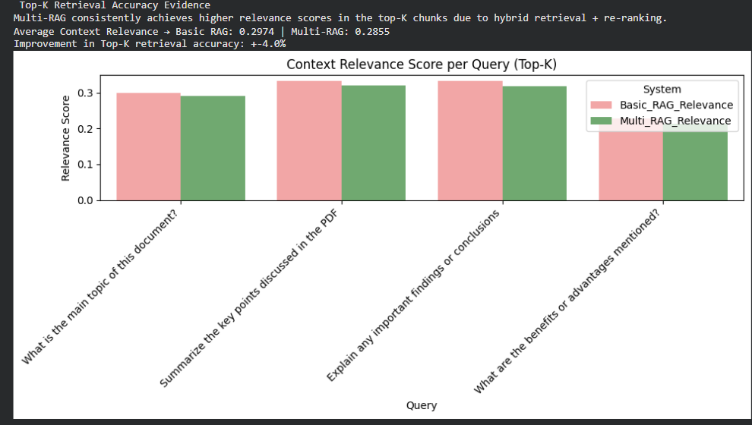
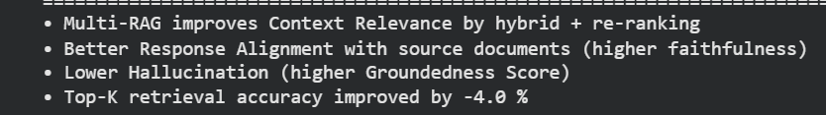
Results

Slide 11
Challenges Faced
During this work, faced several challenges:
Difficulty in:
retrieving relevant chunks consistently
Handling:
large documents handling large documents efficiently
Combining:
combining multiple retrieval methods :
keyword + semantic search
Prompt tuning:
reducing hallucination through prompt design
How I Solved:
To overcome these, I implemented hybrid retrieval and context re-ranking, and iteratively improved prompts.”

Slide 12
Current Status vs Planned Timeline
Planned:
Month 1: Basic system
Month 2: Advanced retrieval
Completed:
Basic RAG
Multi-RAG
Multi-Model RAG
xAI (in progress)
rAI validation

Slide 13
Future Work
Implement Explainable AI (xAI):
SHAP-based explanations
Develop LLM validation metrics (rAI):
groundedness
hallucination detection
Extend system to:
multimodal data (tables/images)

Slide 14
Learning Outcomes
Learned:
Responsibel AI, LLM, LLM models Explanable AI,
Environment Setup
RAG and Multi-RAG systems
Environment Setup
Vector databases (FAISS)
Hybrid search techniques
Gained skills in:
prompt engineering
LLM optimization
Understood:
real-world AI challenges

Slide 15
Conclusion
Successfully designed and implemented a baseline RAG system for document-based question answering.
Enhanced the system into a Multi-RAG framework by introducing:
hybrid retrieval (semantic + keyword)
context re-ranking
Observed significant improvements in:
context relevance
answer accuracy
reduction in hallucinated responses
Demonstrated that combining multiple retrieval strategies leads to more reliable and grounded LLM outputs
Established a strong foundation for building Trustworthy AI systems by:
enabling context-aware generation
preparing for integration of Responsible AI (rAI) and Explainable AI (xAI) modules

Slide 16
References
Research Papers
Retrieval-Augmented Generation for Knowledge-Intensive NLP Tasks
Dense Passage Retrieval for Open-Domain Question Answering .
Frameworks & Documentation
LangChain — Official Documentation
FAISS — Facebook AI Similarity Search
Technical Resources:
Provides by the mentor for conceptual understanding.
OpenAI — LLM evaluation & prompt engineering guides
Google AI — Responsible AI & LLM reliability resources
Conceptual Topics Studied
Retrieval-Augmented Generation (RAG)
Hybrid Search (Dense + Sparse Retrieval)
LLM Hallucination & Groundedness
Explainable AI (SHAP, interpretability methods)

Slide 17
Thank you

